Slide 1
Credit Card Default
Kajal Shukla

Slide 2
Overview
Retrieved the dataset from University of California, Machine Learning Repository
https://archive.ics.uci.edu/ml/datasets/default+of+credit+card+clients#
There are 24 variables provided against whether or not a customer made their next payment: the credit limit, gender, education, marital status, age, history of past payments, amount of bill statements and amounts of previous payments.

Slide 3
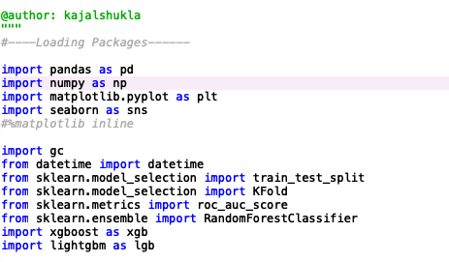
Packages

Slide 4
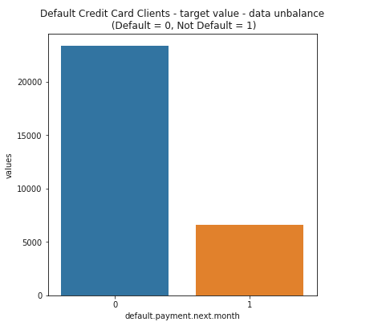
Data exploration
According to the function, data_df.head(), There are 30,000 credit card clients, and the average value for the amount of credit card limit is 167,484.
As the value for 0 for default payment means - Non Default and 1 means that it is default.
The mean for default payment for next payment is 0.221 which means that there are 22.1% of credit card defaults will default next payment.

Slide 5
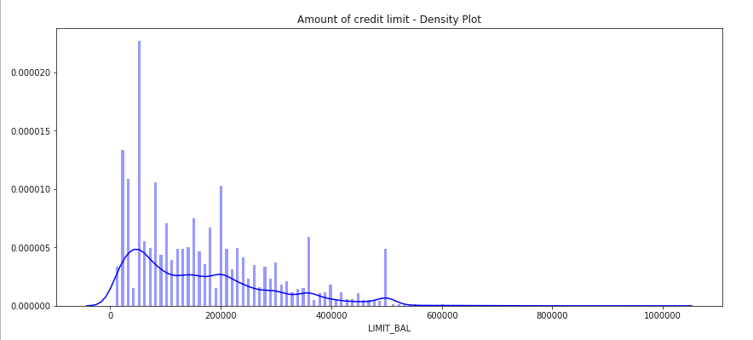
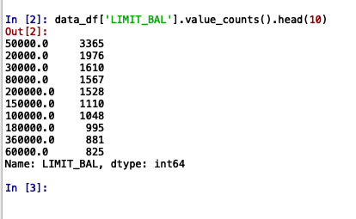
Amount of credit limit
Created a density plot of the credit limit balance.
According to the plot, largest group of amount of credit limit is apparently for amount of 50,000. To verify this, I have used data_df['LIMIT_BAL'].value_counts().head(10) function.

Slide 6
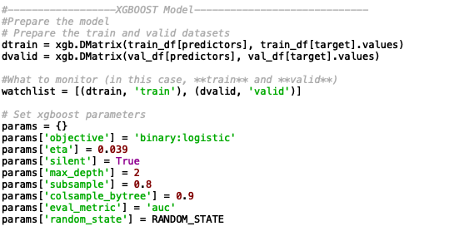
XGBoost Model
Used DMatrix objects for training and validation, to prepare the dataset

Slide 7
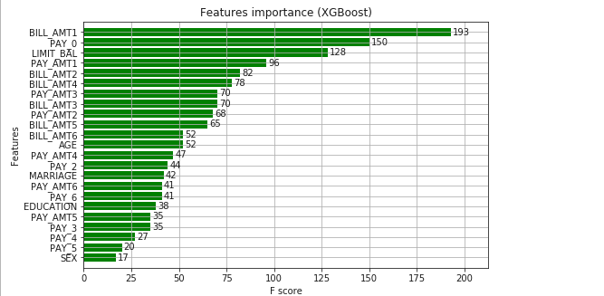
Features Importance of XGBoost
The most important features are:
BILL_AMT1, PAY 0, LIMIT_BAL, PAY_AMT1
BILL_AMT2

Slide 8
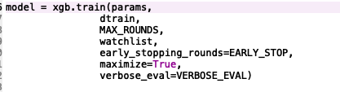
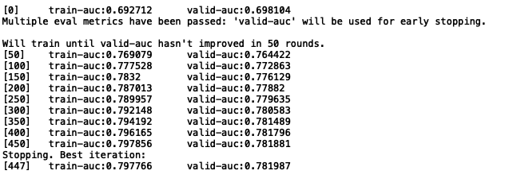
Finding the AUC score for XGBoost
The best validation score is 0.78198 which is round 447.

Slide 9
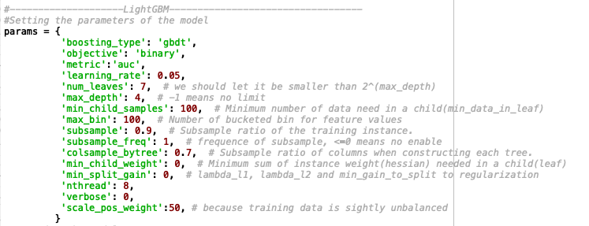
LightGBM Model
Set the parameters for the model

Slide 10
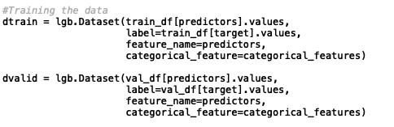
Defining the categorical values
Used lgb function to initialize the Datasets with the list of categorical features.

Slide 11
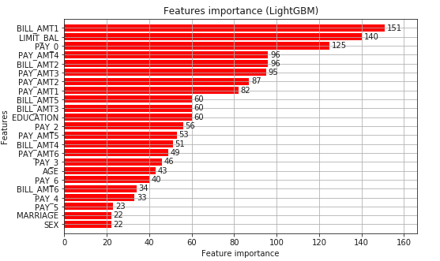
Features Importance of LightGBM
The most important features are Bill_Amt1
Limit_Bal,
Pay 0,
Pay_Amt4,
Bill_Amt2,
Pay_Amt3

Slide 12
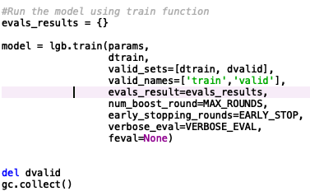
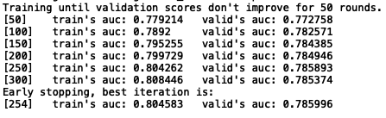
Finding the AUC score for LightGBM
The best validation score is 0.78599 which is round 254

Slide 13
Comparison of XGBoost and LightGBM
AUC score for XGBoost is 0.78198
AUC score for LightGBM is 0.78599
This means that LightGBM has higher AUC score than XGBoost which means that prediction of LightGBM model has higher probability to show the default of credit of the customers.

